Slide 1
Discrete Structures
CS-1005
GCR: e2d2awt
Lecture-6

Slide 2
Propositional Logic
Just as in algebra, operators have precedence
4+3*2 = 4+(3*2), not (4+3)*2
Example
This means that
p ∨ q ∧ ¬r → s ↔ t yields: (p ∨ (q ∧ (¬r)) → s) ↔ (t)
Operator | Precedence
¬ | 1
∧ | 2
∨ | 3
→ | 4
↔ | 5

Slide 3
Propositional Logic
Construct the truth table of following compound propositions
p →￢p
p ⊕ p
(q →￢p) ↔ (p ↔ q)

Slide 4
Propositional Logic
Translating English Sentences
“I have neither given nor received help on this exam”
Let p = I have given help on this exam
q = I have received help on this exam
¬p ∧¬q
Rephrase: It is not the case that either I have given or received help on this exams
¬(p ∨ q)

Slide 5
Propositional Logic
“If I go to Harry’s or to the country, I will not go shopping.”
Let p = I go to Harry’s
q = I go to the country.
r = I will go shopping.
If p or q then not r
(p ∨ q) → ￢r

Slide 6
Propositional Logic
“You can access the Internet from campus only if you are a computer science major or you are not a freshman.”
Let a = You can access the Internet from campus
c = You are a computer science major
and f = You are a freshman” respectively
a only if c or not f
a → (c ∨￢f ).

Slide 7
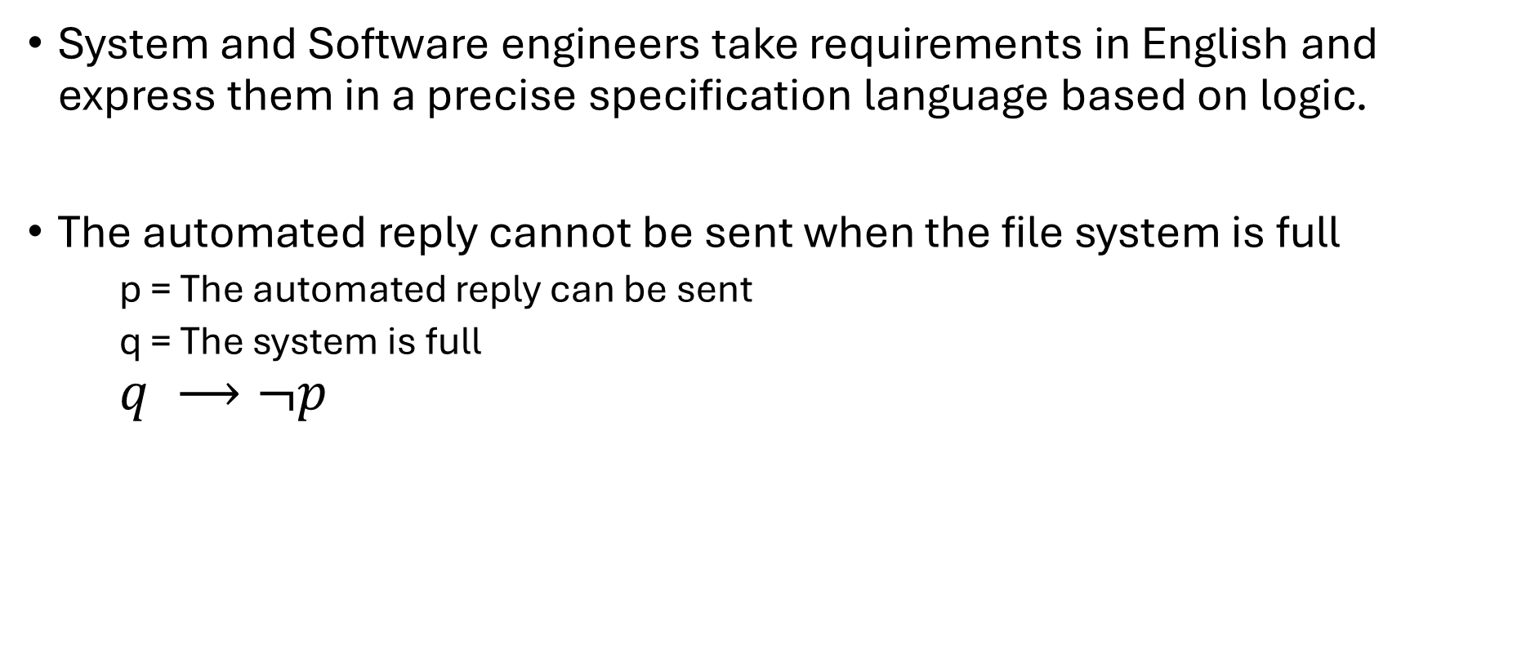
Propositional Logic
System and Software engineers take requirements in English and express them in a precise specification language based on logic.
The automated reply cannot be sent when the file system is full
p = The automated reply can be sent
q = The system is full
$$q ⟶¬p$$

Slide 8
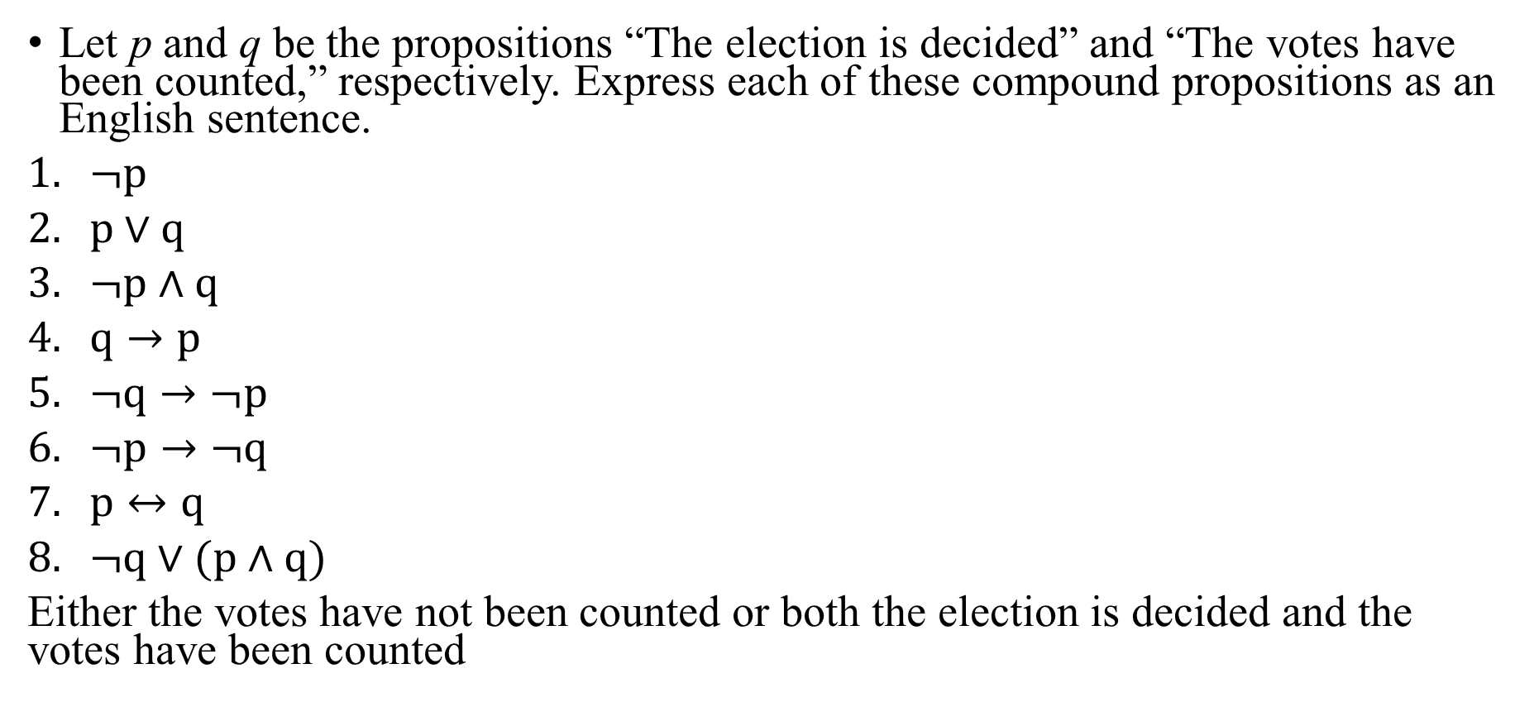
Propositional Logic
Let p and q be the propositions “The election is decided” and “The votes have been counted,” respectively. Express each of these compound propositions as an English sentence.
$¬p$
$p∨q$
$¬p∧q$
$q→p$
$¬q→¬p$
$¬p→¬q$
$p↔q$
$¬q∨(p∧q)$
Either the votes have not been counted or both the election is decided and the votes have been counted

Slide 9
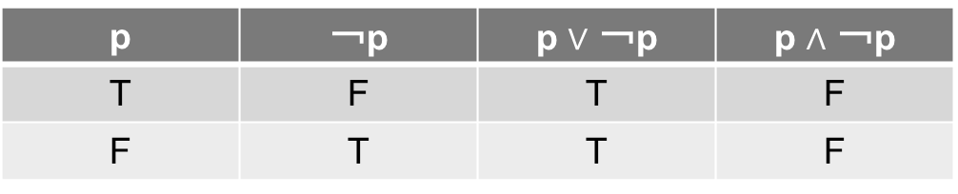
Tautology and Contradiction
A compound proposition that is always true, no matter what the truth values of the propositional variables that occur in it, is called a tautology. A compound proposition that is always false is called a contradiction.

Slide 10
Logical Equivalence
An important type of step used in a mathematical argument is the replacement of a statement with another statement with the same truth value
Propositional Equivalence is extensively used in the construction of mathematical arguments.

Slide 11
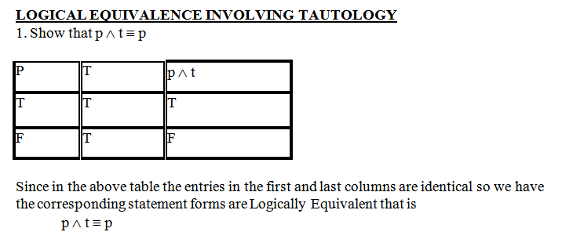
Logical Equivalence

Slide 12
Logical Equivalence
Compound propositions that have the same truth values in all possible cases are called logically equivalent.
The compound propositions p and q are called logically equivalent if p ↔ q is a tautology.
The notation p ≡ q denotes that p and q are logically equivalent.

Slide 13
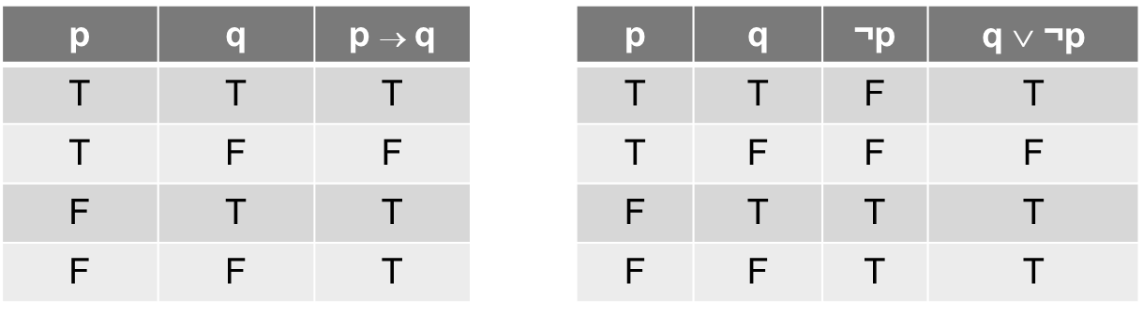
Logical Equivalence

Slide 14
Logical Equivalence
Converse
The proposition q → p is converse of p → q.
Contrapositive
The contrapositive of p → q is the proposition ￢q →￢p.
Inverse
The proposition ￢p →￢q is called the inverse of p → q.

Slide 15
Logical Equivalence
 |  |  |  | Implication | Inverse | Converse | Contrapositive
p | q | ¬p | ¬q | p → q | ¬p → ¬q | q → p | ¬q → ¬p
T | T | F | F | T | T | T | T
T | F | F | T | F | T | T | F
F | T | T | F | T | F | F | T
F | F | T | T | T | T | T | T

Slide 16
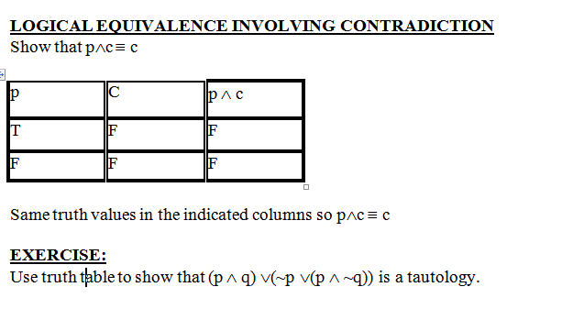
Logical Equivalence

Slide 17
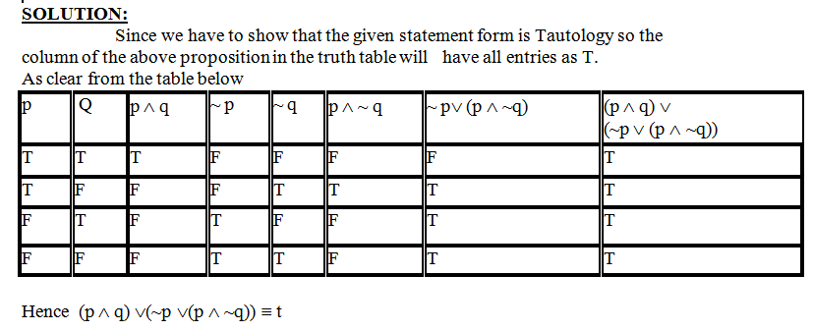
Logical Equivalence

Slide 18
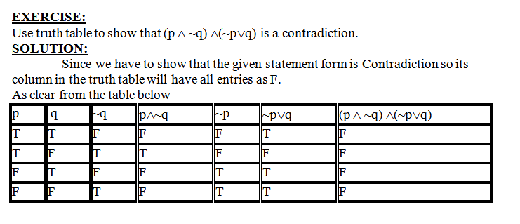
Logical Equivalence

Slide 19
Logical Equivalence
Equivalence | Name
p ∧ T ≡ p p ∨ F ≡ p | Identity laws
p ∨ T ≡ T p ∧ F ≡ F | Domination laws
p ∨ p ≡ p p ∧ p ≡ p | Idempotent laws
￢(￢p) ≡ p | Double negation law
p ∨ q ≡ q ∨ p p ∧ q ≡ q ∧ p | Commutative laws
(p ∨ q) ∨ r ≡ p ∨ (q ∨ r) (p ∧ q) ∧ r ≡ p ∧ (q ∧ r) | Associative laws
p ∨ (q ∧ r) ≡ (p ∨ q) ∧ (p ∨ r) p ∧ (q ∨ r) ≡ (p ∧ q) ∨ (p ∧ r) | Distribution Laws

Slide 20
Logical Equivalence
Distributive: p ∨ (q ∧ r) ≡ (p ∨ q) ∧ (p ∨ r)
p | q | r | q ∧ r | p ∨ (q ∧ r) | (p ∨ q) | (p ∨ r) | (p ∨ q) ∧ (p ∨ r)
T | T | T | T | T | T | T | T
T | T | F | F | T | T | T | T
T | F | T | F | T | T | T | T
T | F | F | F | T | T | T | T
F | T | T | T | T | T | T | T
F | T | F | F | F | T | F | F
F | F | T | F | F | F | T | F
F | F | F | F | F | F | F | F

Slide 21
Logical Equivalence
Equivalence | Name
￢(p ∧ q) ≡ ￢p ∨￢q ￢(p ∨ q) ≡ ￢p ∧￢q | De Morgan’s laws
p ∨ (p ∧ q) ≡ p p ∧ (p ∨ q) ≡ p | Absorption laws
p ∨￢p ≡ T p ∧￢p ≡ F | Negation laws

Slide 22
Logical Equivalence
Logical Equivalence involving Implication
p → q ≡ ￢p ∨ q
p → q ≡ ￢q →￢p
p ∨ q ≡ ￢p → q
p ∧ q ≡ ￢(p →￢q)
￢(p → q) ≡ p ∧￢q
(p → q) ∧ (p → r) ≡ p → (q ∧ r)
(p → r) ∧ (q → r) ≡ (p ∨ q) → r
(p → q) ∨ (p → r) ≡ p → (q ∨ r)
(p → r) ∨ (q → r) ≡ (p ∧ q) → r

Slide 23
Logical Equivalence
Logical Equivalence involving Bi-conditional
p ↔ q ≡ (p → q) ∧ (q → p)
p ↔ q ≡ ￢p ↔￢q
p ↔ q ≡ (p ∧ q) ∨ (￢p ∧￢q)
￢(p ↔ q) ≡ p ↔￢q

Slide 24
Logical Equivalence
Show that ¬(p ∧ ¬q) ∨ q ≡ ¬p ∨ q is logically equivalent.
¬(p ∧ ¬q) ∨ q
(¬p ∨ ¬¬q) ∨ q DeMorgan’s
(¬p ∨ q) ∨ q Double negation
¬p ∨ (q ∨ q) Associative
¬p ∨ q Idempotent

Slide 25
Logical Equivalence
Show that (p ∧ q) → q is a Tautology.
Proof:
(p ∧ q) → q
¬(p ∧ q) ∨ q Implication
(¬ p ∨ ¬ q) ∨ q De Morgan
¬ p ∨ (¬ q ∨ q) Associative
¬ p ∨ T Negation
T Dominations

Slide 26
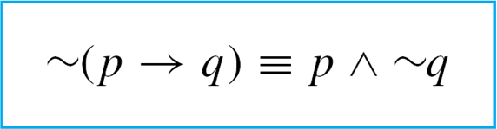
Propositional Logic
By definition, p → q is false if, and only if, its hypothesis, p, is true and its conclusion, q, is false. It follows that
This can be restated symbolically as follows:

Slide 27
Propositional Logic
Write negations for each of the following statements:
If my car is in the repair shop, then I cannot get to class.
If Sara lives in Athens, then she lives in Greece
Solution:
My car is in the repair shop and I can get to class.
Sara lives in Athens and she does not live in Greece.

Slide 28
Propositional Logic
Write each of the following statements in its equivalent contrapositive form:
If Howard can swim across the lake, then Howard can swim to the island.
If today is Easter, then tomorrow is Monday.
Solution:
If Howard cannot swim to the island, then Howard cannot swim across the lake.
If tomorrow is not Monday, then today is not Easter.

Slide 29
Propositional Logic
Write the converse and inverse of each of the following statements:
If Howard can swim across the lake, then Howard can swim to the island.
If today is Easter, then tomorrow is Monday.
Solution:
Converse: If Howard can swim to the island, then Howard can swim across the lake.
Inverse:
If Howard cannot swim across the lake, then Howard cannot swim to the island.
b. Converse: Inverse:
If tomorrow is Monday, then today is Easter.
If today is not Easter, then tomorrow is not Monday.

Slide 30
Valid and Invalid Arguments
A valid argument has a structure that ensures the truth of the conclusion if the premises are true.
Example of a Valid Argument:
Premise 1: All humans are mortal.
Premise 2: Ali is a human.
Conclusion: Therefore, Ali is mortal.
If both premises are true, then the conclusion must be true. There is no way for the premises to be true and the conclusion to be false, so this argument is valid.

Slide 31
Valid and Invalid Arguments
An invalid argument has a structure that does not guarantee the truth of the conclusion, even if all the premises are true.
Premise 1: All cats are animals.
Premise 2: My dog is an animal.
Conclusion: Therefore, my dog is a cat.
Even though both premises are true, the conclusion does not logically follow. The argument incorrectly assumes that because my dog is an animal, it must also be a cat, which is not a valid inference. Therefore, this argument is invalid.

Slide 32
Valid and Invalid Arguments
Testing an Argument Form for Validity
Identify the premises and conclusion of the argument form.
Construct a truth table showing the truth values of all the premises and the conclusion.
A row of the truth table in which all the premises are true is called a critical row. If there is a critical row in which the conclusion is false, then it is possible for an argument of the given form to have true premises and a false conclusion, and so the argument form is invalid.
If the conclusion in every critical row is true, then the argument form is valid.

Slide 33
Valid and Invalid Arguments
p → q ∨ ~ r
q → p ∧ r
∴p → r

Slide 34
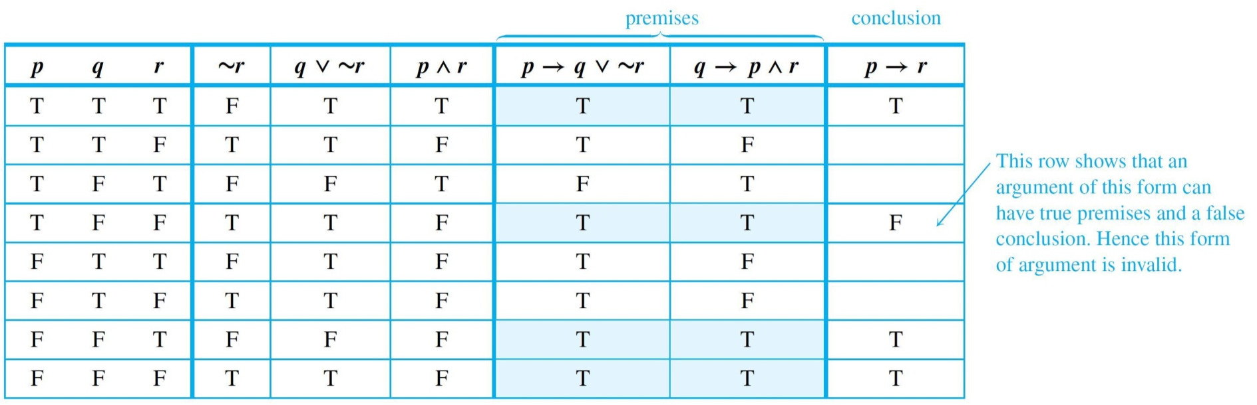
Valid and Invalid Arguments

Slide 35
Rule of Inference
A rule of inference is a logical tool used in formal reasoning that allows one to derive a conclusion from one or more premises (statements assumed to be true). It is a fundamental concept in logic, mathematics, and computer science, providing a systematic way to determine the validity of arguments.

Slide 36
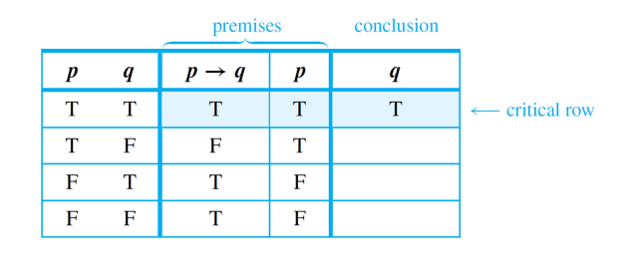
Rules of Inference
Rule of Inference
Modus Ponens
p → q
If x divisible by 6, x divisible by 3 18 divisible by 6
∴ 6 divisible by 3
p
∴ q

Slide 37
Rules of Inference
Rule of Inference
Modus Tollens
p → q
if Zeus is human, then he is mortal Zeus is not human
∴ Zeus is not mortal
∼ q
∴ ∼ p
p | q | p-> q | ~q | ~p
T | T | T | F | F
T | F | F | T | F
F | T | T | F | T
F | F | T | T | T
premises
conclusion

